Slide 1

Gen AI Sales Insight Assistant
Leveraging artificial intelligence for smarter sales strategies
Notes:
AI-generated content may be incorrect. ---

Slide 2
Overview
Notes:
Project Introduction

Slide 3

Project Introduction
AI-Powered Dashboard
The assistant is an AI-driven dashboard that simplifies and accelerates sales data analysis.
Technology Stack
Built on Python and Streamlit integrating ChatGPT and local language models for enhanced insights.
User Interaction
Users upload CSV files, apply filters, and ask questions using natural language for analysis.
Benefits
This tool reduces manual effort, improves decision-making, and democratizes data access across teams.
Notes:
The Gen AI Sales Insight Assistant is an AI-powered dashboard designed to streamline sales data analysis. Built using Python and Streamlit, it integrates ChatGPT and a local language model to provide real-time insights, interactive visualizations, and automated reporting. Users can upload CSV files, apply filters, and ask natural language questions to uncover trends and strategies. This tool reduces manual effort, enhances decision-making, and democratizes data access across teams.

Slide 4
Problem Statement
Notes:
Challenges in Sales Data Analysis

Slide 5

Challenges in Sales Data Analysis
Manual Data Cleaning
Sales analysts spend excessive time cleaning data manually, which is repetitive and prone to errors.
Lack of Real-Time Interactivity
Current processes lack real-time interactive tools, causing delays and missed opportunities in decision-making.
Need for Automation and Insights
There is a need to automate repetitive tasks and provide instant insights for intuitive data exploration.
Notes:
Sales analysts often spend significant time manually cleaning data, generating reports, and identifying trends. This process is repetitive, error-prone, and lacks real-time interactivity. The absence of intelligent tools leads to delays in decision-making and missed opportunities. There is a pressing need for a solution that automates these tasks, provides instant insights, and allows for intuitive data exploration.

Slide 6
Solution Description
Notes:
Gen AI Sales Insight Assistant Features

Slide 7

Gen AI Sales Insight Assistant Features
Natural Language Insights
Integration with ChatGPT enables users to obtain insights using natural language queries quickly and easily.
Local Language Model Support
Supports local language models for private data inference, ensuring data security and privacy.
Interactive Filters
Users can filter sales data by region, category, and date range for customized analysis.
Dynamic Charts and Uploads
Dynamic charts display KPIs visually, complemented by CSV upload functionality for data import.
Notes:
The Gen AI Sales Insight Assistant offers a comprehensive solution for sales data analysis. Key features include: integration with ChatGPT for natural language insights, support for local language models for private inference, interactive filters for region, category, and date range, dynamic charts and KPIs, and CSV upload functionality. These features empower users to explore data intuitively and receive actionable insights instantly.

Slide 8
Technical Architecture
Notes:
High-Level Workflow

Slide 9
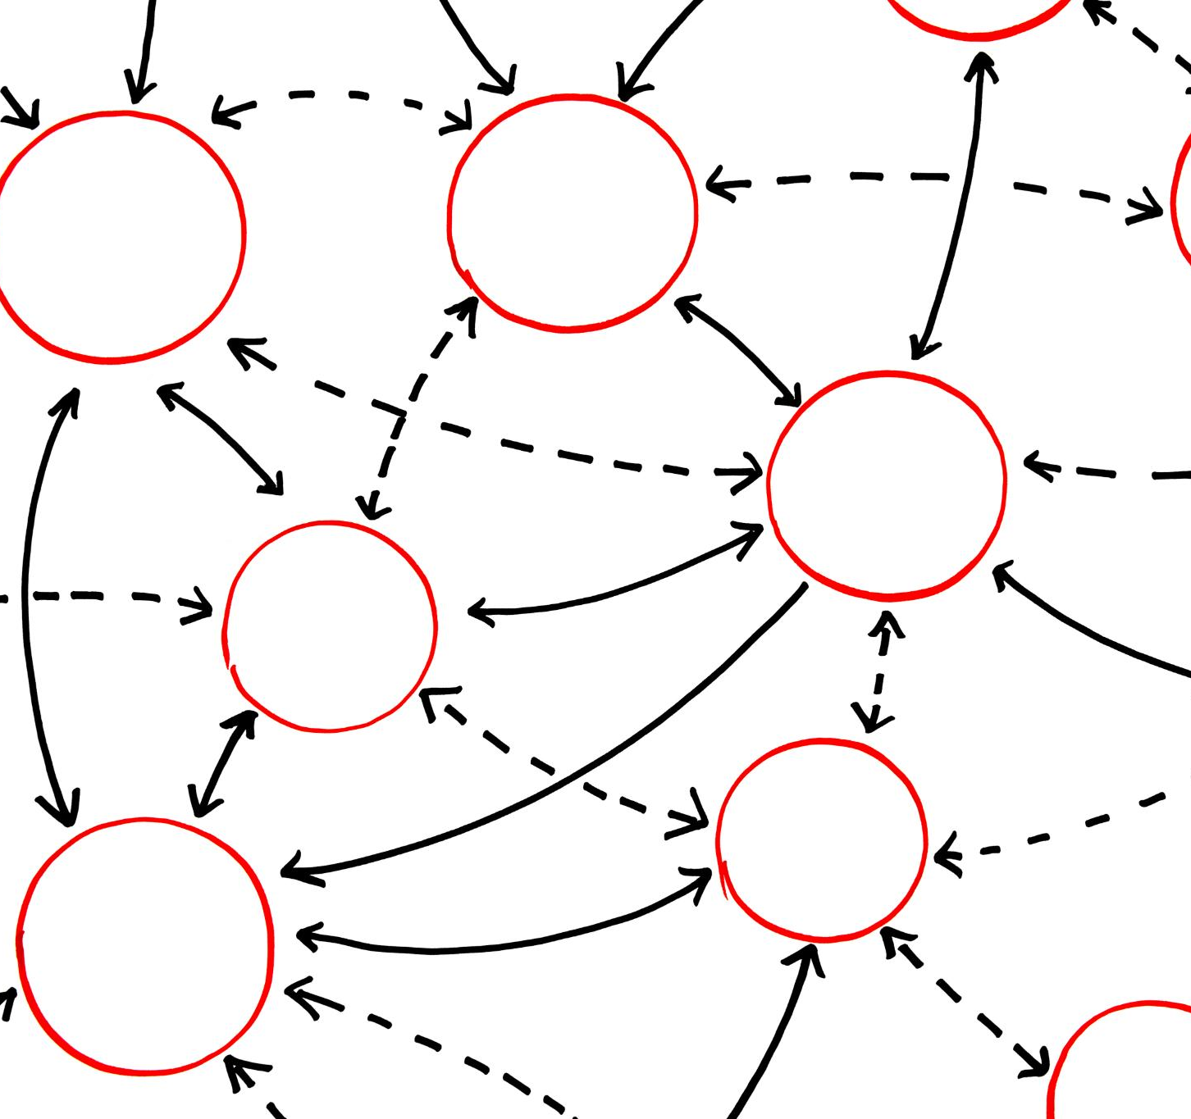
High-Level Workflow
Data Ingestion
Data is ingested via CSV uploads or database connections for further processing.
Data Preprocessing
Pandas is used for cleaning and transforming raw data for analysis readiness.
Analysis Engine
Analysis is performed using ChatGPT or local language models via APIs like OpenAI or FastAPI.
Visualization & Feedback
Streamlit visualizes insights and users refine queries, creating a feedback loop for improved results.
Notes:
The technical workflow of the assistant includes: 1) Data ingestion via CSV upload or database connection, 2) Preprocessing using pandas for cleaning and transformation, 3) Analysis engine powered by ChatGPT or a local language model accessed via OpenAI API or FastAPI, 4) Visualization layer built with Streamlit, and 5) Feedback loop where users refine queries and regenerate insights. This architecture ensures scalability, flexibility, and real-time responsiveness.

Slide 10
Technology Stack
Notes:
Python Libraries Used

Slide 11

Python Libraries Used
Data Manipulation Library
Pandas is used for efficient data manipulation and analysis, enabling structured data handling.
Visualization Libraries
Matplotlib and Seaborn create detailed and aesthetic visualizations for data insights.
User Interface and API Tools
Streamlit builds interactive dashboards, while FastAPI and Uvicorn handle API serving and server running.
AI Integration Library
OpenAI library enables seamless integration with ChatGPT for intelligent data application features.
Notes:
The assistant leverages several Python libraries: pandas for data manipulation, matplotlib and seaborn for visualizations, streamlit for dashboard UI, openai for ChatGPT integration, requests for API communication, fastapi for serving local models, and uvicorn for running the FastAPI server. These libraries provide robust functionality and seamless integration for building intelligent data applications.

Slide 12
Demo Walkthrough
Notes:
Step-by-Step Interaction

Slide 13
Step-by-Step Interaction
Launching Dashboard
Users begin by launching the Streamlit dashboard for interactive data analysis.
Uploading Data File
Users upload a sales CSV file to input data for analysis.
Applying Data Filters
Filters for region, category, and date range refine the dataset dynamically.
Viewing Dynamic Charts
Dynamic charts display total revenue and top categories based on filtered data.
Asking Natural Language Queries
Users ask questions like seasonal trends using natural language input.
Receiving AI Insights
AI models generate insightful responses based on user queries and data.
Notes:
Users interact with the assistant through the following steps: 1) Launch the Streamlit dashboard, 2) Upload a sales CSV file, 3) Apply filters for region, category, and date range, 4) View total revenue and top categories via dynamic charts, 5) Ask questions like 'What are seasonal trends?' in natural language, and 6) Receive AI-generated insights from ChatGPT or the local model. This walkthrough demonstrates the assistant’s ease of use and powerful capabilities.

Slide 14
Use Case Scenario
Notes:
Sales Manager Strategy Planning

Slide 15

Sales Manager Strategy Planning
Data Upload and Filtering
The sales manager uploads quarterly data and filters it by region and category for detailed analysis.
Identifying Underperformance
Visualizations help identify regions and categories that are underperforming in sales.
Strategic Improvement Suggestions
The assistant recommends targeted promotions and inventory adjustments to boost sales performance.
Data-Driven Decision Making
This use case demonstrates how AI tools support strategic planning with actionable insights.
Notes:
A regional sales manager uploads quarterly sales data and filters by region and category. The assistant identifies underperforming areas using visualizations. The manager then asks ChatGPT for improvement strategies. The assistant suggests targeted promotions and inventory adjustments. This use case illustrates how the assistant enables data-driven decision-making and strategic planning.

Slide 16
Contributors
Notes:
Project Team

Slide 17

Project Team
Human Leadership
The lead developer guided concept creation, data analysis, and dashboard design with expert insight.
AI Assistance
AI contributed to code generation, logic optimization, visualization, and integration support effectively.
Human-AI Collaboration
This project highlights the synergy between human expertise and AI capabilities driving innovation.
Notes:
The Gen AI Sales Insight Assistant was developed by Raghunandan Malpani, who led the concept, data analysis, and dashboard design. Microsoft Copilot AI Assistant contributed to code generation, logic optimization, visualization, and integration support. This collaboration showcases the synergy between human expertise and AI capabilities.

